Slide 1
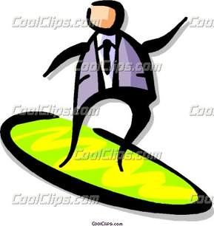
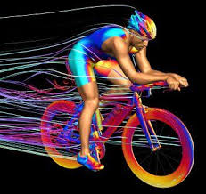
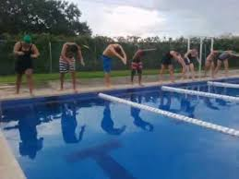
Cognitive Target 1: Achievements of our national athletes
Vocabulary & Grammatical Summaries
based on Contents given by MEP for “Bachillerato a tu Medida” EnglishTesting

Slide 2
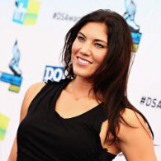
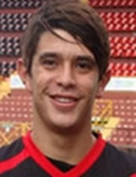
Vocabulary 1
Goalkeeper Defender Midfielder Forward Coach/trainer
Solo Salvatierra Zidane Colindres Watson

Slide 3
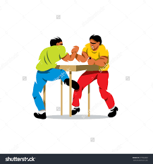
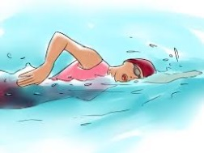
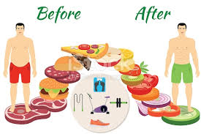
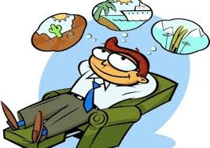
Vocabulary 2
female-gold medal-reach-career-notable-compete-athlete-swimmer-start-before-after-retire

Slide 4
Simple Past Tense of Verb “Be”
Verb Be Simple present
I am a tennis player.
You are a good swimmer.
He is a retired sprinter.
She is good at archery.
Diving is her sport.
We are tennis players.
You are fast runners.
They are international soccer teams.
Verb Be
Simple Past
I was /were a tennis player.
You were a good swimmer.
He was a retired sprinter.
She was good at archery.
Diving was her sport.
We were tennis players.
You were fast runners.
They were international soccer teams.
am-are
is
Be simple present
was
were
Be simple past

Slide 5
Simple past Regular Verbs
Regular verbs form their past tense by adding “ed” at the end of the basic verb. Examples:
Basic and Simple Past form of Regular verbs
Admire
Simple Past: admired
Close
Simple Past: closed
Show
Simple Past: showed
Amaze
Simple Past: amezed
Open
Simple Past: opened
Enter
Simple Past: entered
Visit
Simple Past: visited
She amazed us at the yoga presentation.
He opened the door for us.
They entered in the 10 km race.
Hernán showed his good skills in last night’s game..
He admired players like Evaristo Coronado, Shirley Cruz and Leo Messi.
Heredia and Saprissa closed one of the tournament episodes last Wednesday.
Few of Saprissa’s fans visited Heredia stadium last Wednesday.

Slide 6
Regular verbs ending in “Y” Past tense Forms
1.Maintain the basic form and add “ed”
Enjoy-play-pray-stay
-He enjoyed friends visiting.
-They played tennis.
-He prayed every day.
She stayed one week in Perú-
Basic form changes “Y” to “ied”
Study-try-fry-accompany
-He studied French.
-I tried eating healthy.
-They fried late.
-Aerocasillas carried the package.
-She accompanied her children till the end.
2.Basic form changes
Buy-say-fly
-Tom bought it in China.
-We said “no” to the proposal.
-They flew last night.

Slide 7
Simple Past Irregular Verbs
Irregular Verbs in simple past may fall into any of the following categories:
Irregular Verbs Past tense Categories
1.Basic form and past tense are the same
Beat-put-set-cost-let-
cut-burst-hurt-
2.Basic form changes vowel
Take-hold-fall-lead
Begin-break-get–win-speak
3.Basic form and past tense have different endings
Send-make-have-eat-
take-go

Slide 8
Some Examples of Past Tense Verb categories
Category #1
Heredia’s team put Saprissa in a bad position last night.
Category #3
Someone set the wrong score last night..
Tickets for the game cost a lot.
Victor Núñez cut all the goal possibilities for Saprissa.
Three goals really hurt the Saprissistas’ self-esteem.
The players sent positive messages to their fans.
Category #2
The amount of goals scored unto Saprissa broke my heart.
.Coach Watson spoke, ; but blamed no players.
The team won.; but did not convince.
Fans got angry with Dave last Wednesday.
After the game they held a press conference with Heredia and Saprissa’s trainner.
An Heredian fan said” The team made us happy.”
Both teams’ players had to train very hard to get to the finals.
Lots of people ate junk food while watching the game.
Many fans took pictures of their favorite players last night.
Fortunately, nothing went wrong after the game between the fans.
The game began at 8:00pm.
Heredia beat Saprissa yesterday.

Slide 9
One More Simple past verb category and examples
Irregular Verbs with more than one past form
Fit
fit/fitted
Leap
leaped/leapt
Shine
Shone/shined
Dream
dreamed/dreamt
Speed
sped-/speeded
Players dreamed with the cup.
Fans dreamt with the cup.
The uniforms fit perfectly.
The uniforms fitted perfectly.
Colindres leaped after a kick.
Colindres leapt after a kick.
Myrie sped, but unsuccessfully.
Myrie speeded, but unsuccessfully.
Most of Heredia’s players shone.
Most of Heredia’s players shined.

