Slide 1
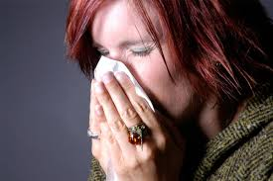
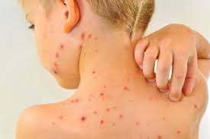
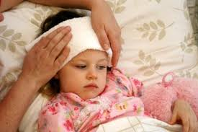
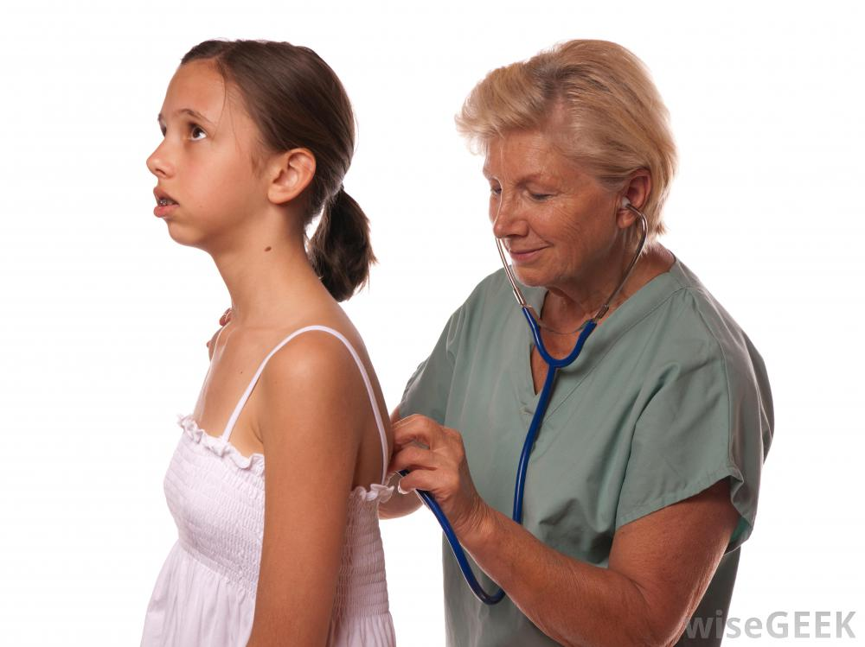
Cognitive Target 1: Common illnesses and new diseases and epidemics
Vocabulary & Summaries
Contents Given by MEP for “Bachillerato a Tu Medida” english Testing

Slide 2
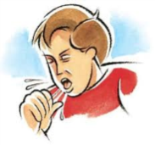
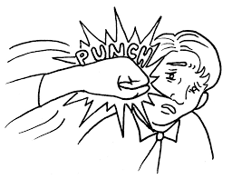
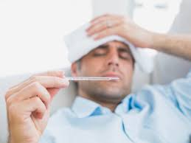
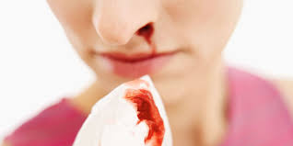
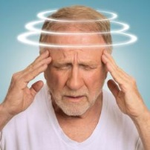
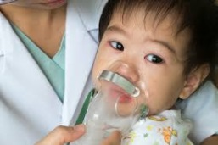
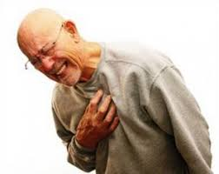
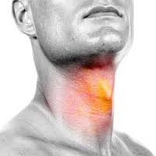
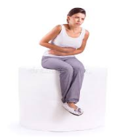
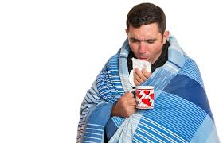
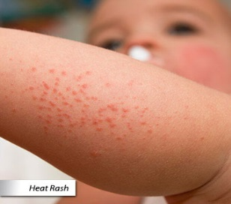
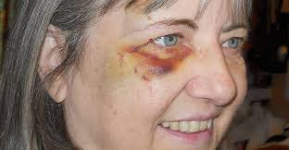
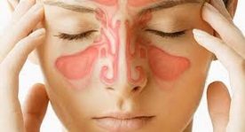
Vocabulary 1
cough: headache: hurts :
temperature (fever) bleed itch :
dizzy: trouble breathing: pain: sore
Stomachache backache earache toothache
Ache : hoarse cold:
congestion (stopped up) : rash : bruise

Slide 3
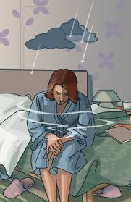
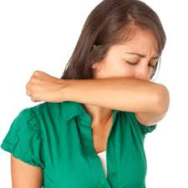
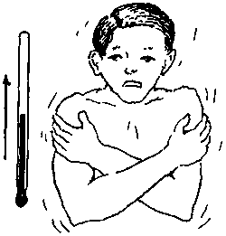
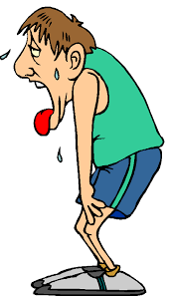
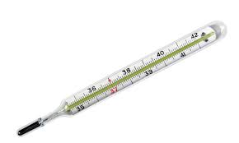
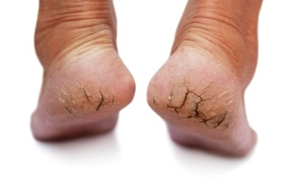
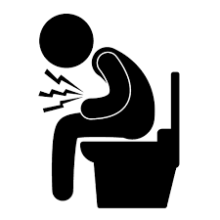
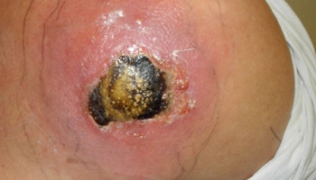
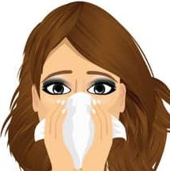
symptoms sneeze: nauseated
Thermometer chills tired
heartburn dry and cracked flu
diarrhea infection runny nose

Slide 4
Old and New diseases
Old infectious Diseases
HIV-HPV-Ebola-Trichomoniais-
Herpes-gonorrhea-Ulcers-Syphilis-
Hepatitis-Chlamydia-Chikungunya-
Dengue-Zika
New Infectious Diseases
Leishmaniasis-
Rift Valley Fever
Oropouche-Mayaro-
Elizabethkingia

Slide 5
Important Verbs to Know
Verb | Simple present | Present continous | Simple past | Pasrt continous | Present participial | Past participial | Present Perfect | Past perfect
Affect | Singular
I | affect | Am affecfting | affected | Was affecting | Is affected | Was affected | Have affected | Had affected
You | affect | Are affecting | affected | Were affecting | Are affected | Was affected | Have affected | Had affected
She/he | affects | Is affecting | affected | Was affecting | Is affected | Was affected | Has affected | Had affected
It | affects | Is affecting | affected | Was affecting | Is affected | Was affected | Has affected | Had affected
Plural
We | affect | Are affecting | affected | Were affecting | Are affected | Were affected | Have affected | Had affected
You | affect | Are affecting | affected | Were affecting | Are affected | Were affected | Have affected | Had affected
They | affect | Are affecting | affected | Were affecting | Are affected | Were affected | Have affected | Had affected

Slide 6
Diseases’ Origen
Viral | Bacteria | Zoonist
Rift Valley Fever Oropouche | Elizabethkingia | Leishmaniasis
Chikungunya Dengue | Gonorrhea | Mayaro
HIV Herpes | Ulcers | Zika
HPV Hepatitis | Syphilis Chlamydia | Trichomoniasis Ebola

